Slide 1
LIBRARY MANAGEMENT SYSTEM
A Mini Project Report

Slide 2
Submitted by
RAHUL MAZUMDER (380116010069)
RAJU KUMAR SHARMA (380116010070)
SAKSHI (380116020081)
SAURAV CHOWDHURY (380116010086)
KUMAR SOURABH ANAND (380117114001)

Slide 3
1. INTRODUCTION
  Problem Definition
Library Management System is a project which aims in developing a computerized system to maintain all library-oriented tasks. This project has many features which are generally not available in normal library management system.
In this management system, librarian and student both can login with their respective username and password. The librarian can maintain the database of entering new books and the record of books that have been retrieved or issued, with their respective dates. The key feature of this project is its student login system through which students can manage their own profile and keep a track on the books issued by them with their due date and also pay fine payment on online basis.
The main aim of this project is providing an easy to handle and automated library management system. This project also provides interface between librarian and students.

Slide 4
2.1 Problems faced with Existing System
According to the existing system, there are some problems faced by both librarian and student which are mentioned below-
Tracing a book is difficult
Information about issue/return of the books are not properly mentioned
Fast report generation is not possible
Students have to stand in a long queue
There is no proper information about closing and opening times of library and holidays
There is no clarity on the basis of fine count which sometime leads to dissatisfaction in students.

Slide 5
2.2 Proposed System
The proposed system have the following features-
It provides a better and efficient service to both librarian and students.
Reduce the workload of employee.
Online Notice Board.
Clarity in closing and opening times of library .
Faster retrieval of information about the desired book.
Ease in monitoring the books issued by a student and keep a track on due dates.
Easy way of fine payment.
Record of your fine payment will be sent to your email id.

Slide 6
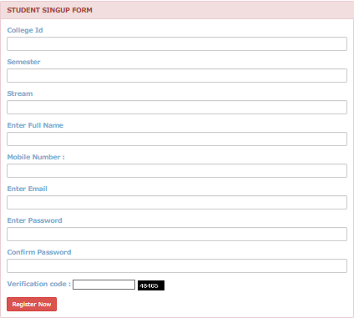
REQUIREMENT SPECIFICATION
Register
Description: First the user will have to register/sign up. There are two different types of users-
1.1 The library manager/head: The manager has to provide details about the name of library, address, phone number, email id.
1.2 Regular person/student: The user has to provide details about his/her name of address, phone number, email id. .

Slide 7
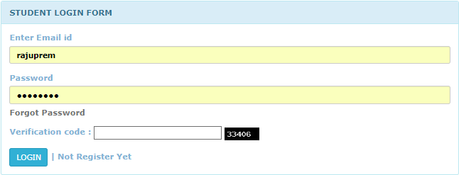
Login
1.Input: Enter the membership number and password provided.
2.Output: User will be able to use the features of software.

Slide 8
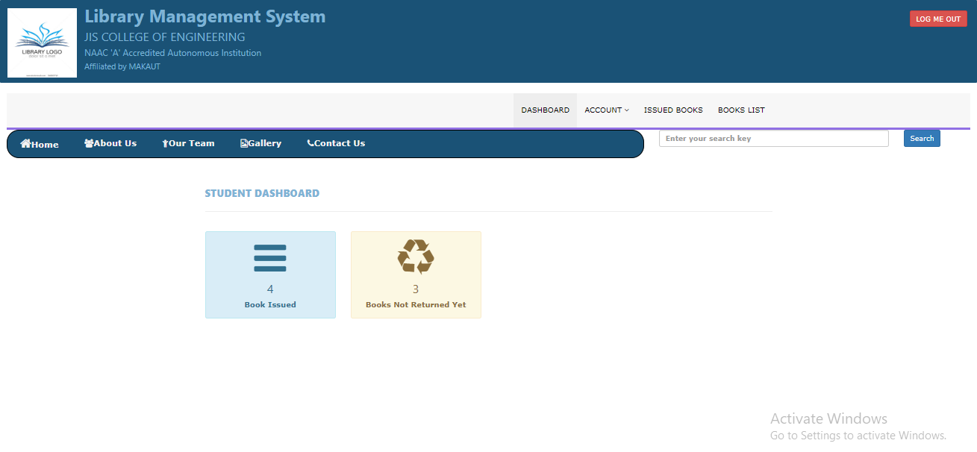

Slide 9
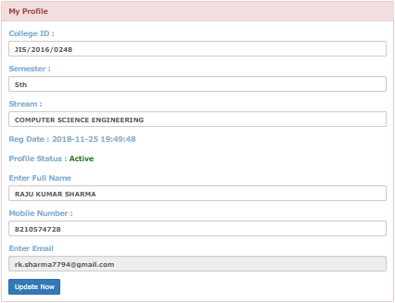
Student Profile

Slide 10
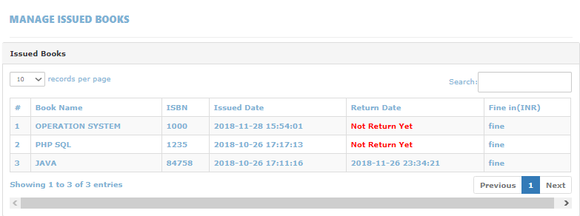
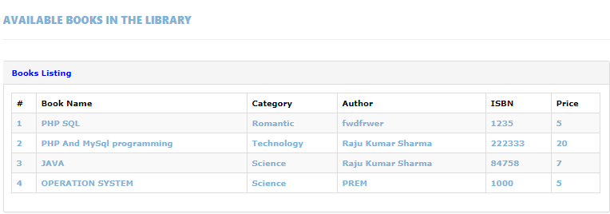
Manage books by students
Books issued
1.Description : List of books will be displaced along with data of return.
Search
1.Input : Enter the name of author's name of the books to be issued.
2. List of books related to the keyword.
Issued book
1.State : Searched the book user wants to issues.
2.Input : Click the book user wants.
3.Output : Confirmation for book issue and apology for failure in issue.

Slide 11
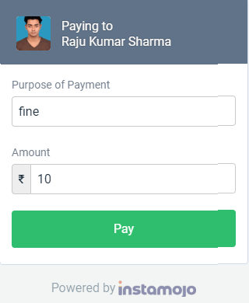
Fine Payment
Input : Check for the fines.
Output: Details about fines on different books issued by the user.
Processing: The fine will be calculated, if it crossed the date of return and the user did not renewed if then fine will be applied by Rs 1 per day.

Slide 12
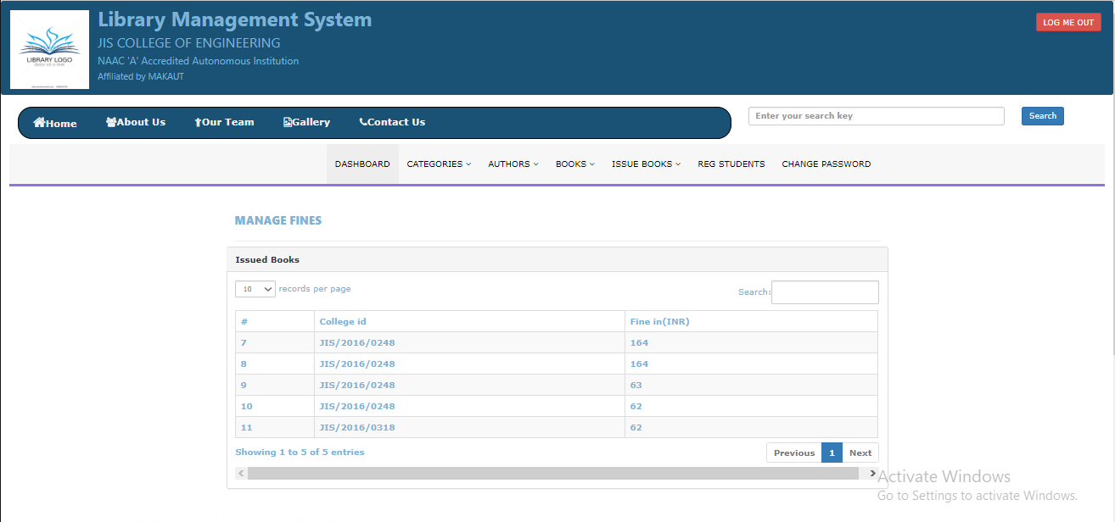
Notes:
Window as viewed by the Librarian

Slide 13
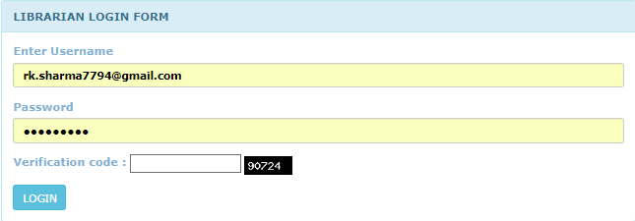
Librarian Log In

Slide 14
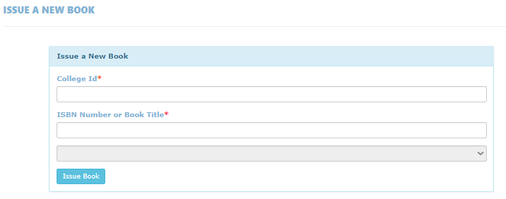
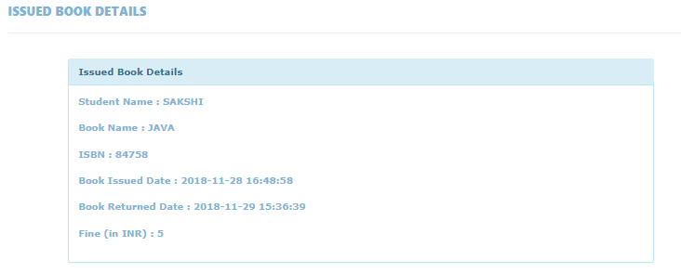
  Manage book by librarian
  Update details of books
Add books
1. Input : Enter the details of the books such as names, author ,edition, quantity.
2. Output : Confirmation of addition.
Remove books
Input : Enter the name of the book and quantity of books.
Output : Update the list of the books available.

Slide 15
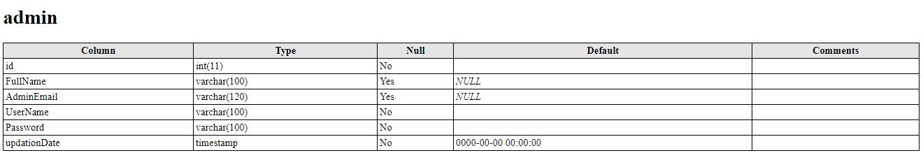
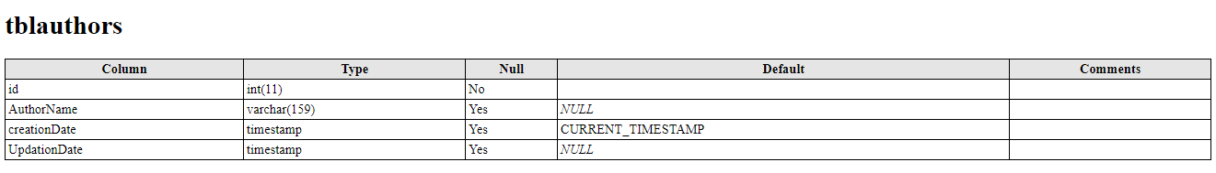
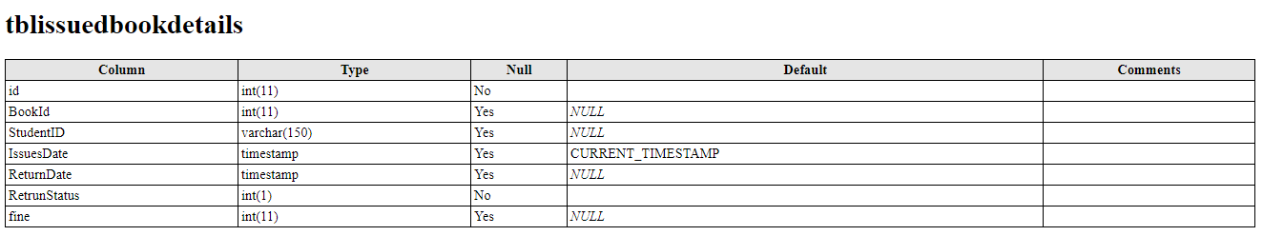
Databases:

Slide 16
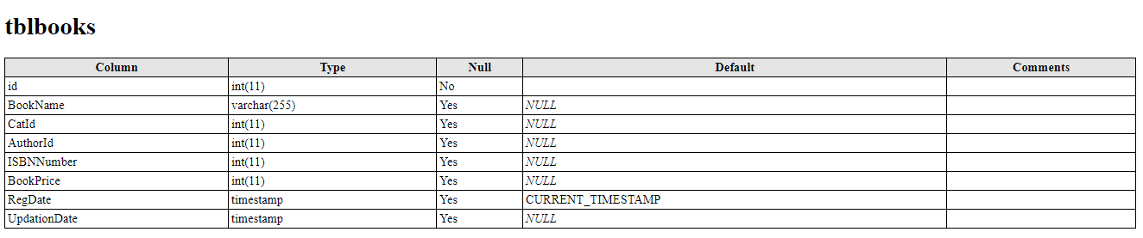
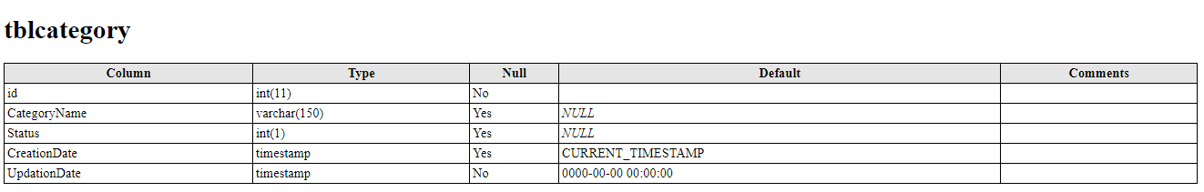
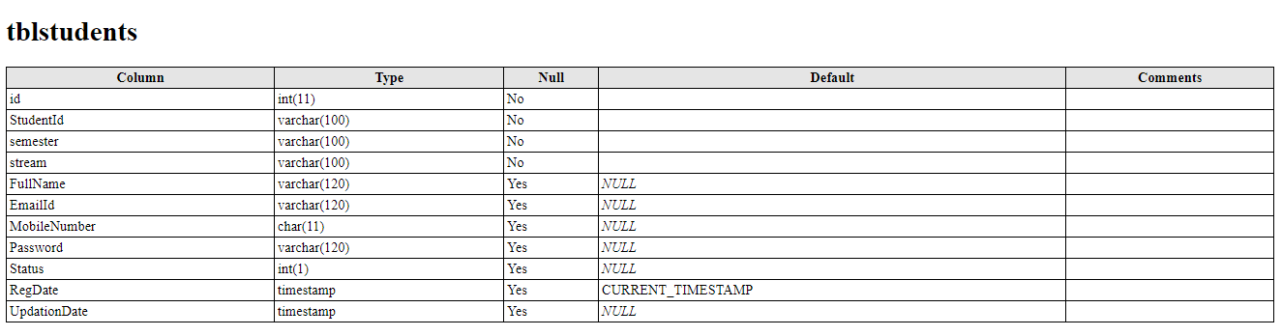

Slide 17
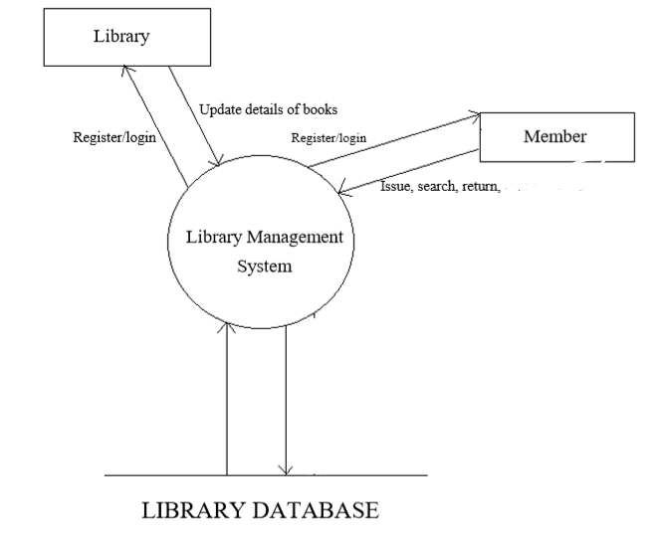
ER DIAGRAMS:-

Slide 18
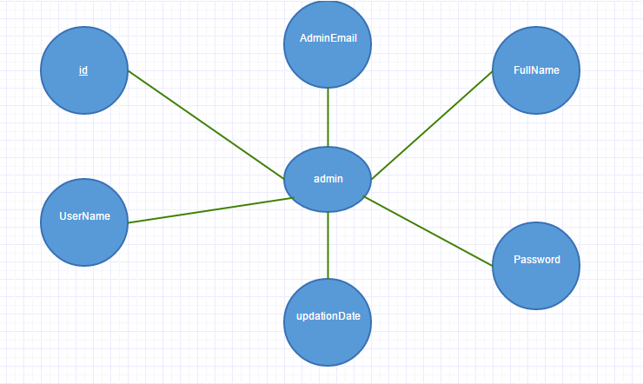
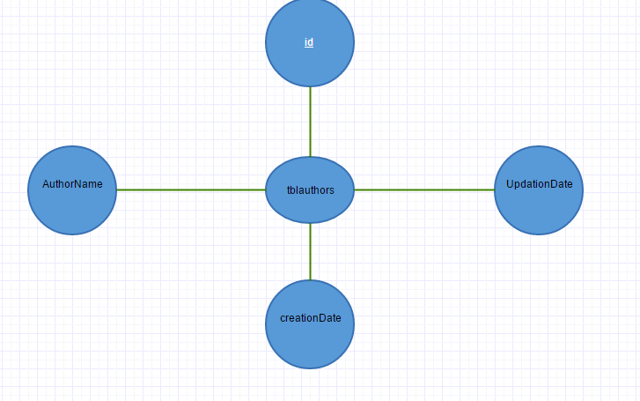
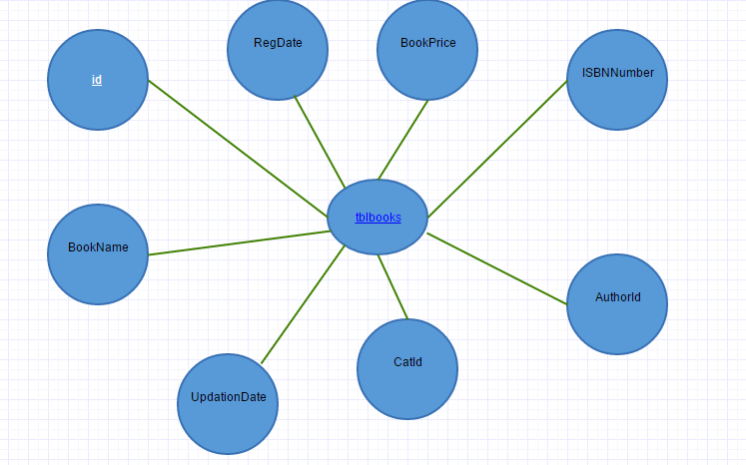
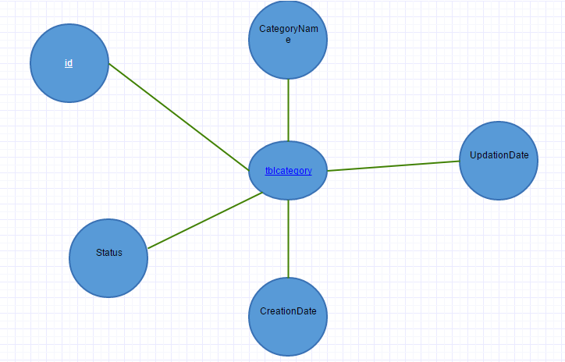

Slide 19
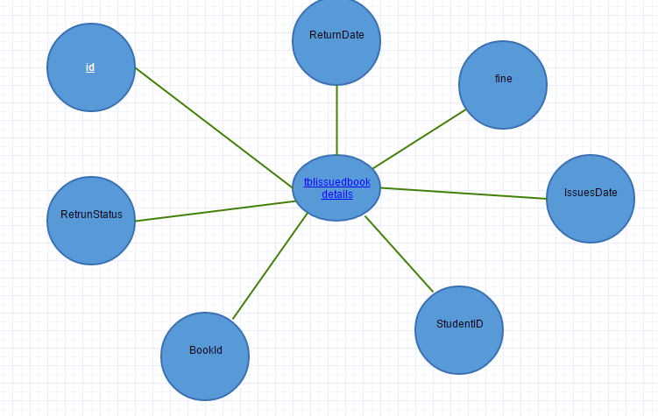
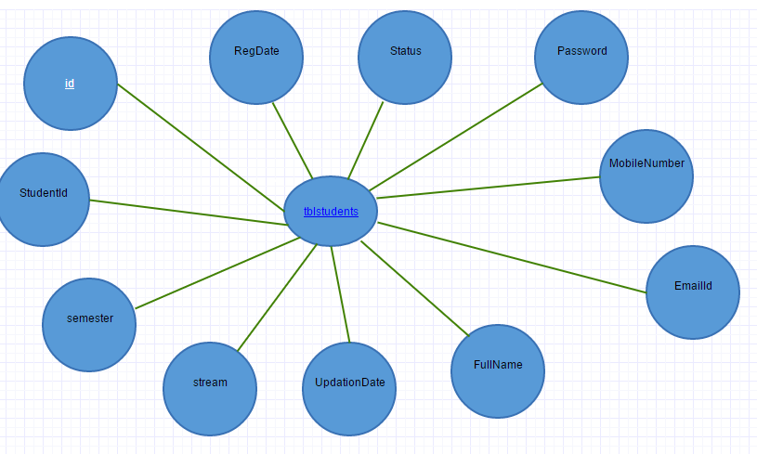

Slide 20
5. CONCLUSIONS
From a proper analysis of positive points and constraints on the component, it can be safely concluded that the project is a highly efficient GUI based component. This software is working properly and meeting to all user requirements.
FUTURE SCOPE
This application can be easily implemented under various situations. We can add new features as and when we require. Reusability is possible as and when require in this application. There is flexibility in all the modules.

